Slide 1
GIS Workshop Pt 1
Summer Data Science Series

Slide 2
Goals:
Projections & coordinate systems
Loading spatial data
Building new layers
Editing data (and metadata)
Making and exporting basic maps
Exporting data

Slide 3
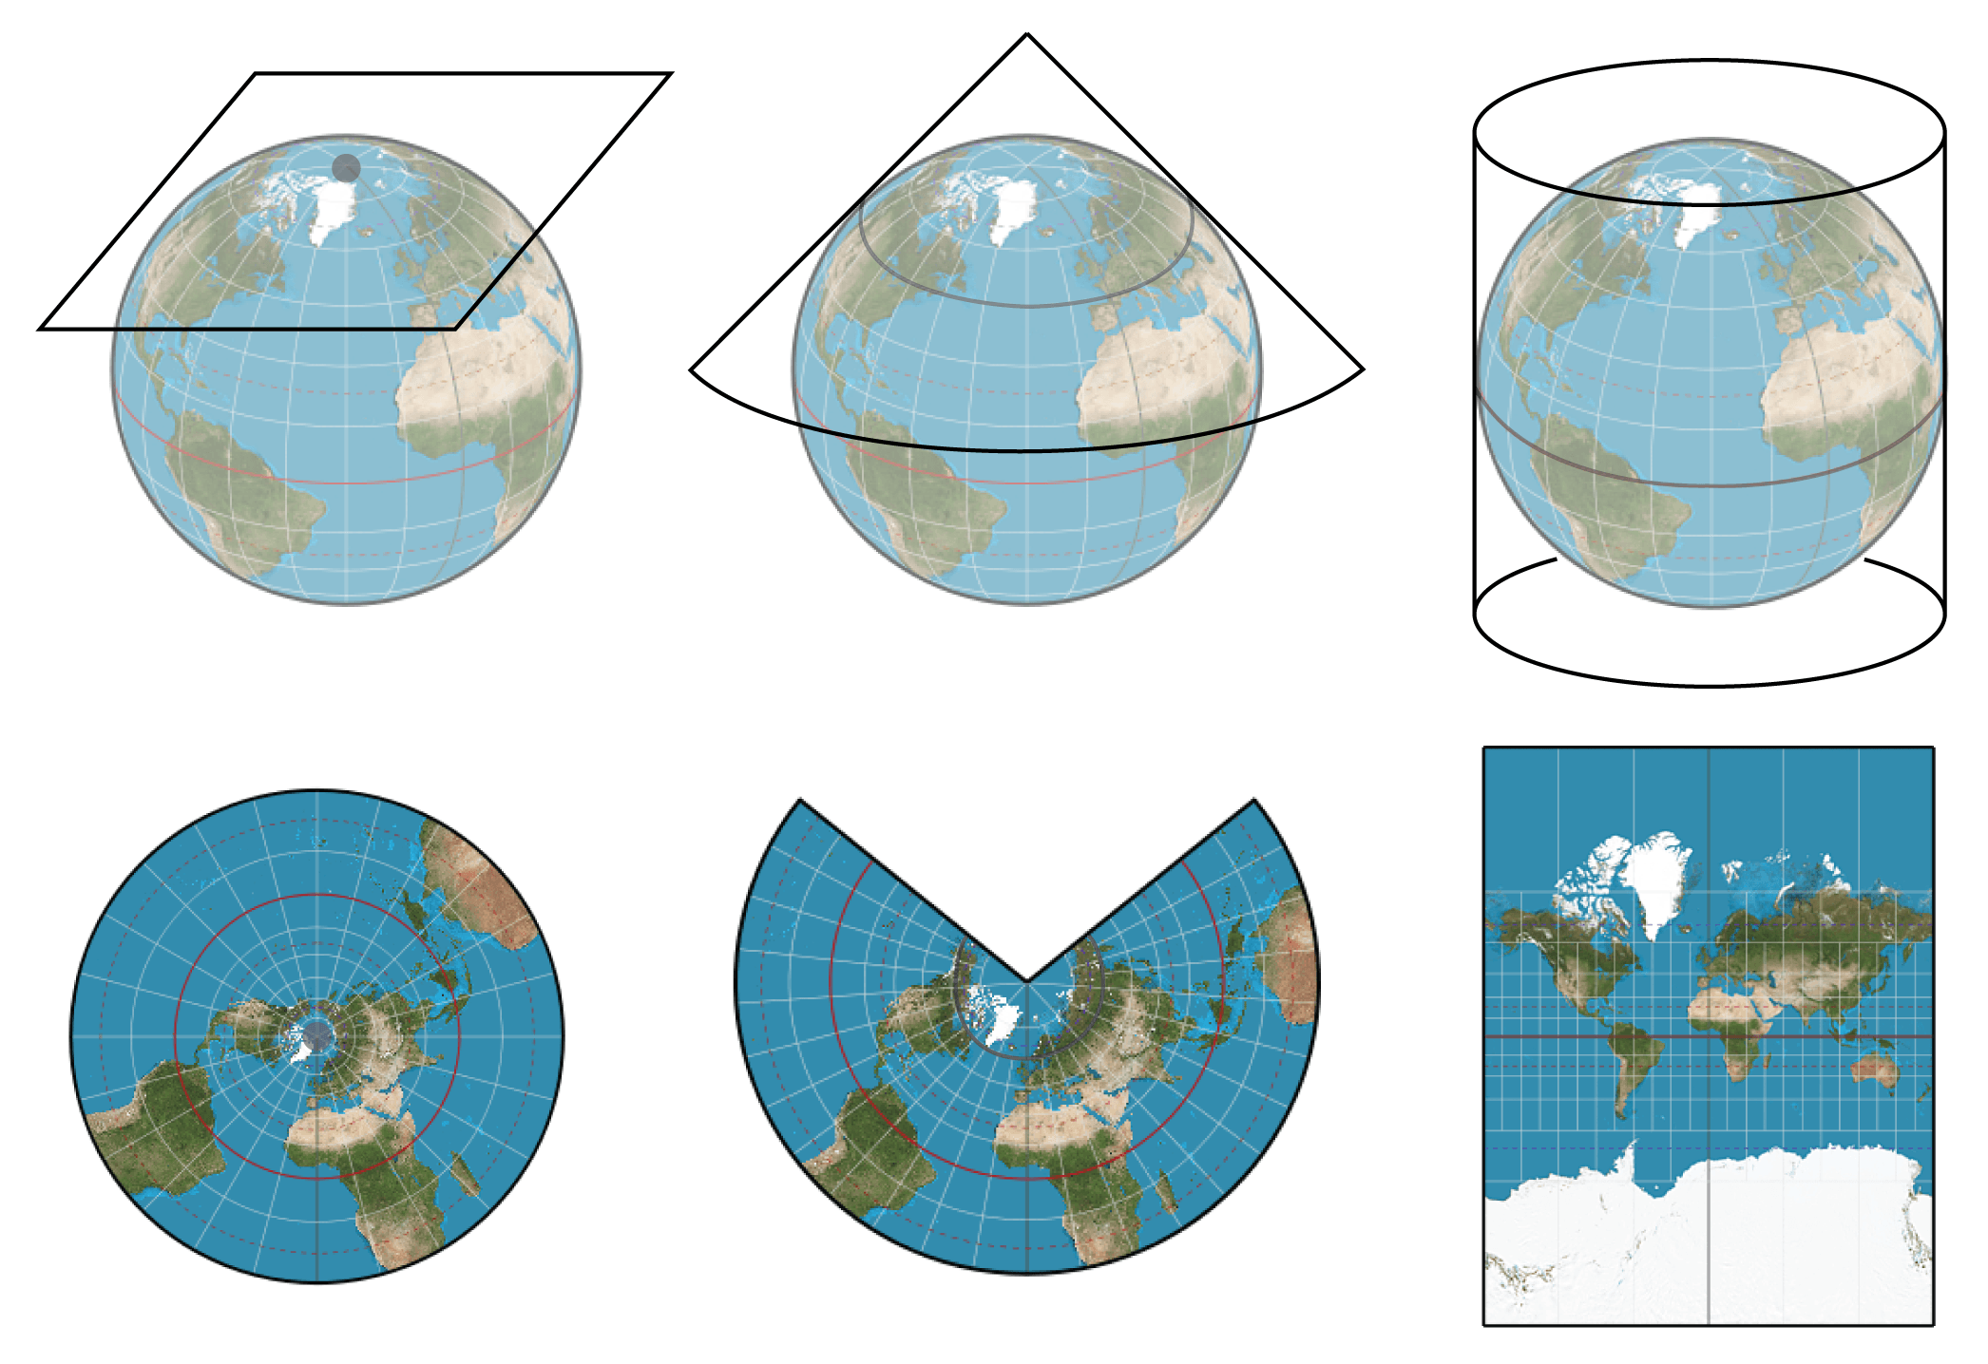
Projections
Azimuthal Equidistant
Lambert Conformal
Mercator

Slide 4
Projections
Area-preserving – Equal Area
Shape-preserving – Conformal or orthomorphic
Distance-preserving – Equidistant, displays the accurate distance between one point and all other points
Direction-preserving – Includes conformal, orthomorphic, and azimuthal projections (only from the central point)

Slide 5
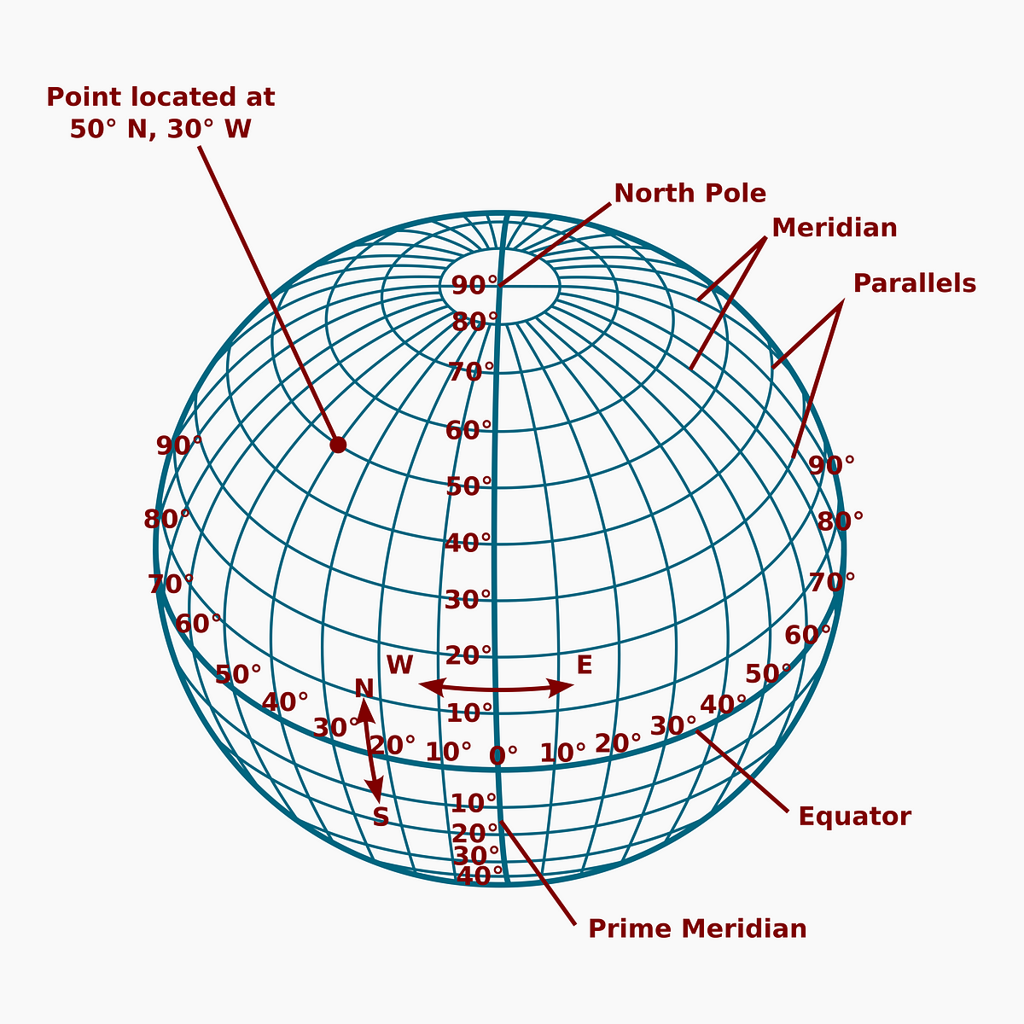
Coordinate Systems
How to place where you are on earth and how you report those coordinates
DMS: 40 degrees, 42 minutes, 51 seconds
Decimal Degrees: 40.714
Web Mercator is default projection for Web Mapping
WGS1984 is common coordinate system (EPSG:4326)

Slide 6
Loading spatial data
Add Data
Points, Lines, Polygons, & CSV
Create Points from Table
CSV
Make NetCDF Raster Layer
NetCDF

Slide 7
Building New Layers
For Building Shapefiles (Points, Lines, Polygons)
Catalog View> folders > [right click on project ] > new > Shapefile
Edit Tab > Create > select layer you want to build
Make sure you save your edits
For Rasters
Create Raster Dataset

Slide 8
Editing Layers
For Editing (Points, Lines, Polygons)
Edit Tab > Modify > select tool > select layer
Make sure you save your edits
Other useful tool:
Clip (analysis tool)
Clip Raster (Data Management Tool)
Note: If something clips weird from a netCDF. Export it to a .tiff first then re-upload and clip

Slide 9
Change Coordinate System or Projection
To see all coordinate systems being used
[Right click on Map in drawing order panel] > properties > coordinate system
To change dataset coordinate system
Define Projection (data management tool)

Slide 10
Mapping!
Insert tab > new layout (choose size)
Map frame (choose extent)
Toggle layers on and off on left panel
Can change symbology and re-name layers from left panel
Right click layer and choose symbology or properties>general to name
Add scale bar and north arrow and legend from top row
Right click on legend and click properties to change unit

Slide 11
Exporting data and maps
Map
Share > export layout (will open panel on the right) > export
DON’T FORGET TO HIT EXPORT
Data
Right click > data > export features

